Slide 1
For Live Session Assignment (FLS)
Unit 13

Slide 2
Quick Quiz Questions

Slide 3
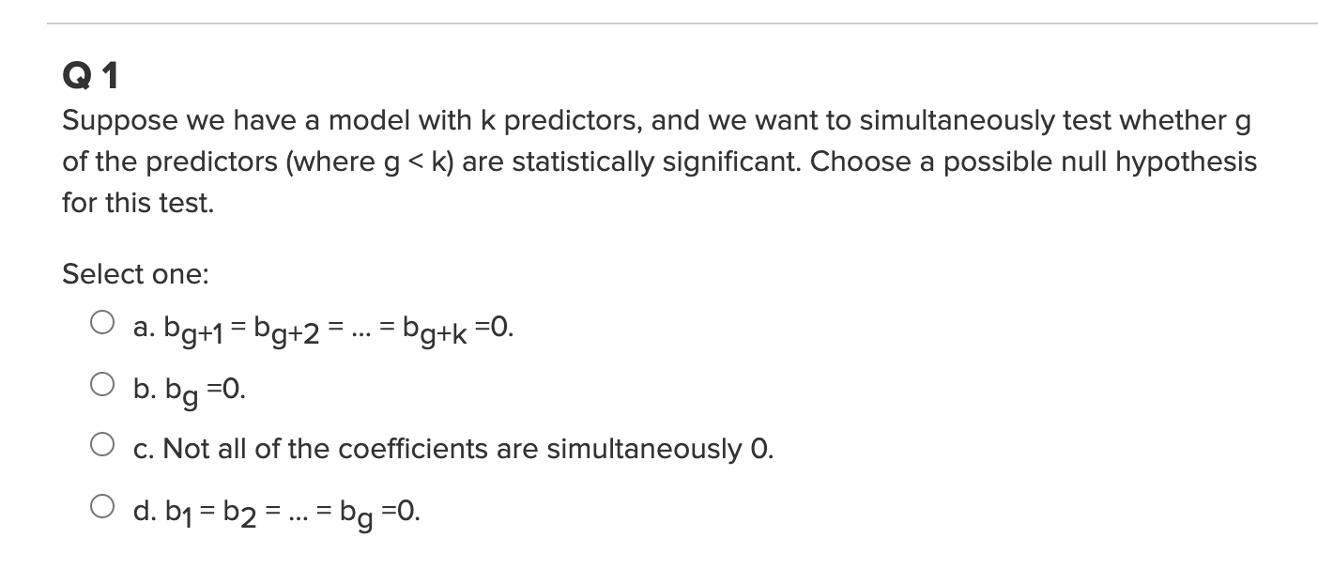
Quick Quiz Questions

Slide 4
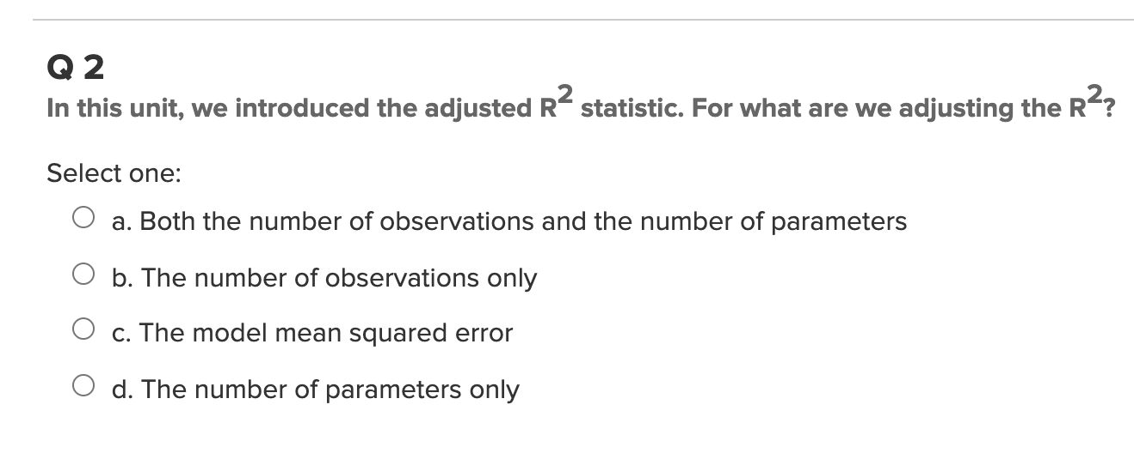
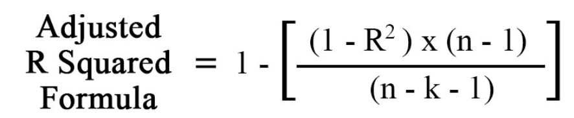
Quick Quiz Questions

Slide 5
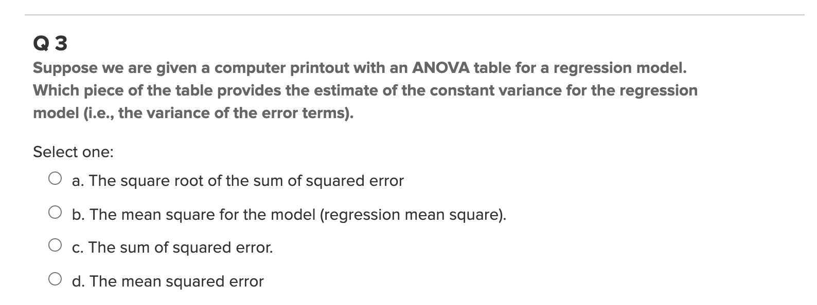
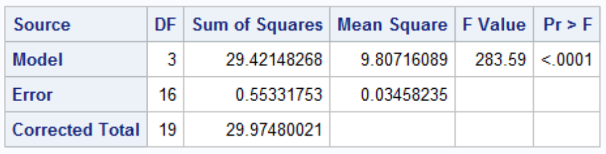
Quick Quiz Questions

Slide 6
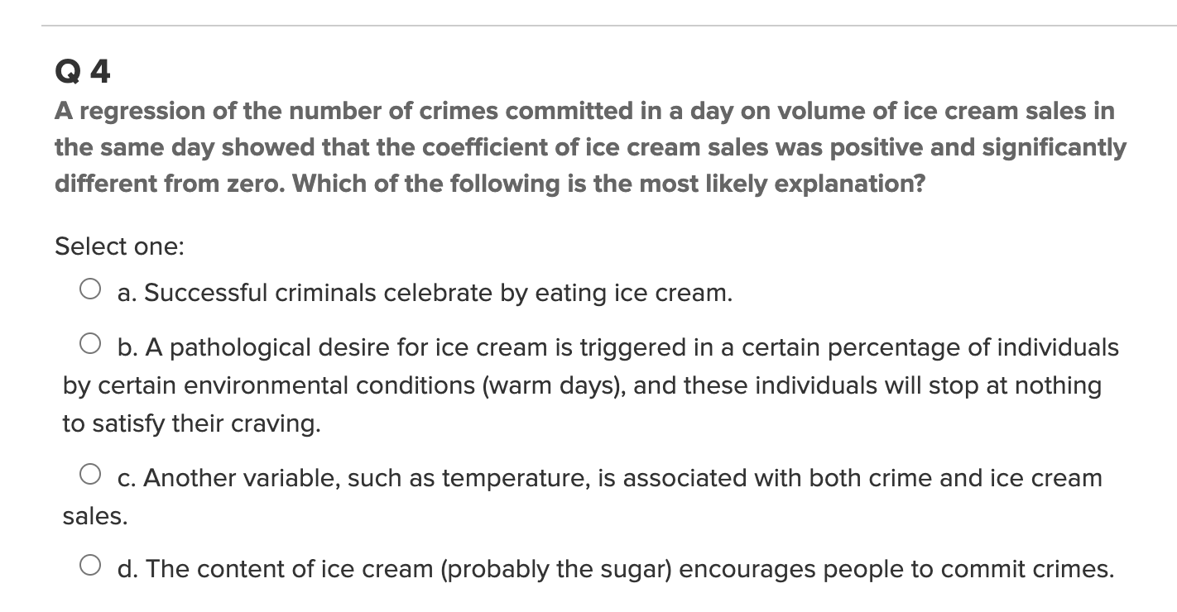
Quick Quiz Questions

Slide 7
Overfitting

Slide 8
Break Out
Use Adjusted R² to try and identify the degree of the model.

Slide 9
Influential Points: Leverage, Studentized Residuals and Cook’s D

Slide 10
Example: Leverage, Studentized Residuals and Cook’s D

Slide 11
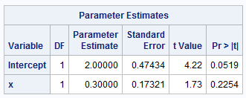
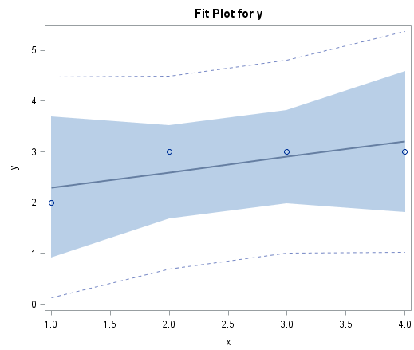
Data Set 1 (Excluded)
subject | x | y | group
1 | 1 | 2 | Exclude
2 | 2 | 3 | Exclude
3 | 3 | 3 | Exclude
4 | 4 | 3 | Exclude
5 | 1 | 2 | Include
6 | 2 | 3 | Include
7 | 3 | 3 | Include
8 | 4 | 3 | Include
9 | 30 | 50 | Include

Slide 12
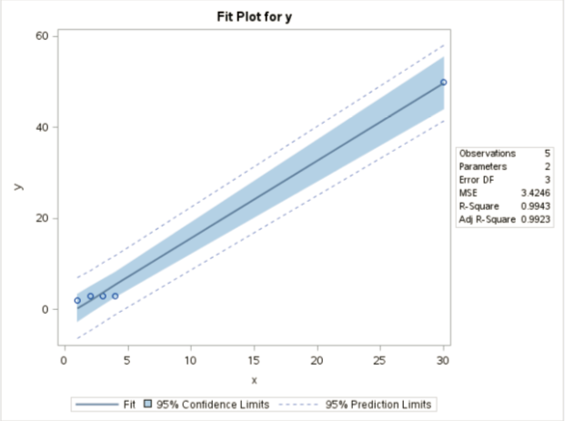
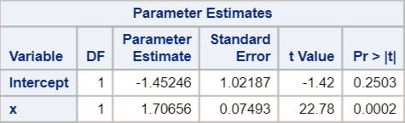
Data Set 2 (Included)
subject | x | y | group
1 | 1 | 2 | Exclude
2 | 2 | 3 | Exclude
3 | 3 | 3 | Exclude
4 | 4 | 3 | Exclude
5 | 1 | 2 | Include
6 | 2 | 3 | Include
7 | 3 | 3 | Include
8 | 4 | 3 | Include
9 | 30 | 50 | Include

Slide 13
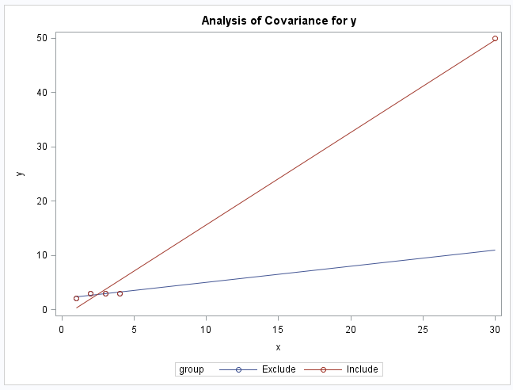
Excluded vs. Included

Slide 14





The Idea of Leverage
$$x_{5}$$
$$x_{1}$$
$$\overline{x}$$
$${(x}_{1}−\overline{x})$$
$${(x}_{5}−\overline{x})$$

Slide 15

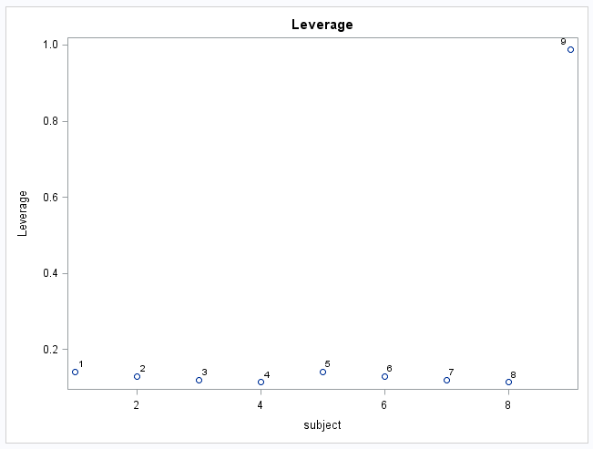
Definition of Leverage (one explanatory variable)
leverage is a function of the distance from X_{i} to X_{bar}, in units of standard deviations
leverage is a function of the proportion of the total sum of squares of the explanatory variable contributed by the i^{th} case
x_{bar}
x_{i}
*combining all 9 pts into one dataset.

Slide 16


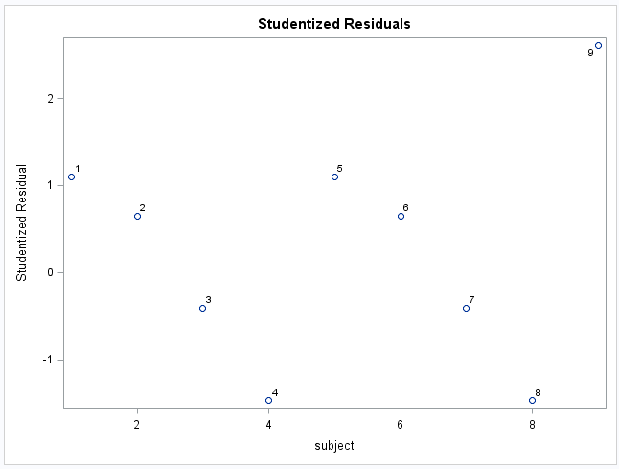
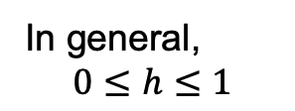
Studentized Residual
In general,
$$0≤h≤1$$
We “standardized” the normally distributed residual, so only 5% of studres_{i} should be more extreme than +-2.

Slide 17
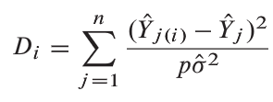


Cook’s Distance (D)

Slide 18
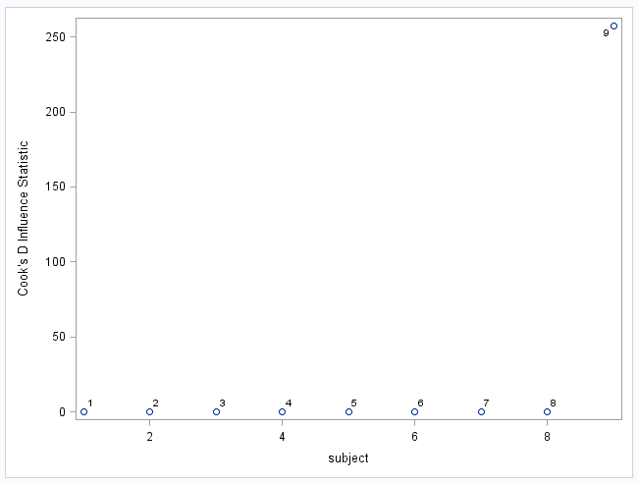
Cook’s D!
A Blend of Both!!!
D > 1 or D > 4/n have more evidence of being influential.
Studentized residual
Residual*
*recall this is wrt reg line without the observation
leverage

Slide 19
Break Out

Slide 20

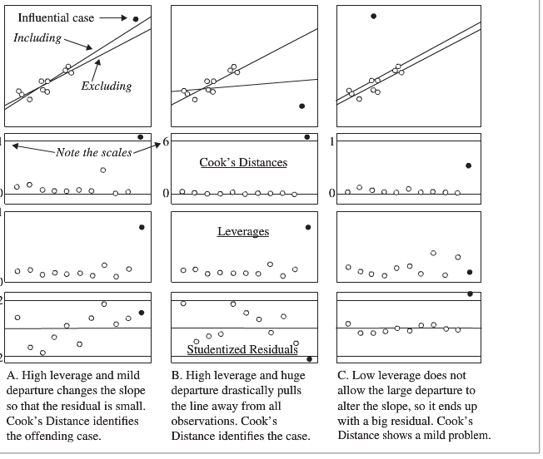
Identify the dark dot as having high or low: leverage, residual and Cook’s D.

Slide 21
Studentized Residuals, Leverage and Cook’s D!

Slide 22
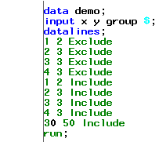
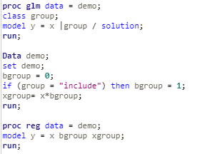
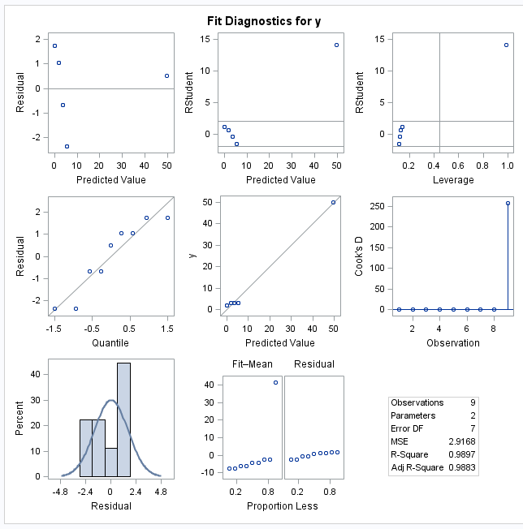
PROC REG or GLM

Slide 23
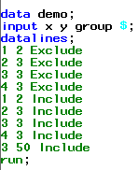
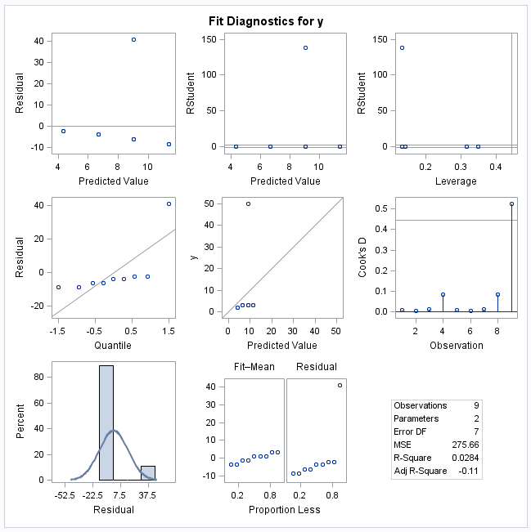
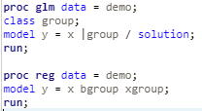
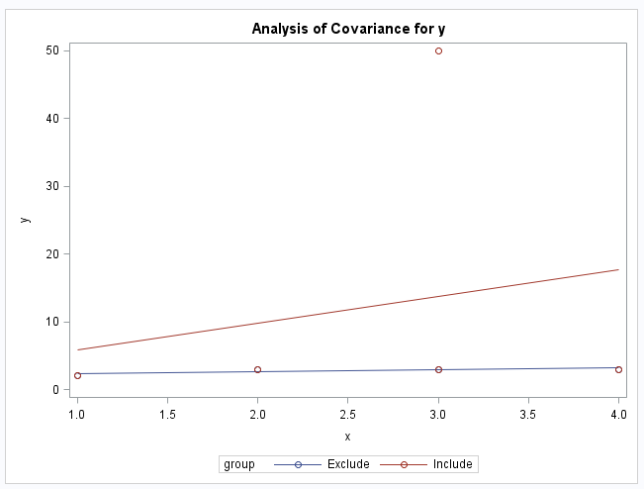
Proc Reg or GLM

Slide 24
Break Out
Identify the observation numbers of the significantly influential points with respect to Cook’s Distance. Do they have relatively high leverage and / or Studentized Residual?

Slide 26
End Quick Quiz Questions

Slide 27
Question 1

Slide 28
Chalk Talk

Slide 29
Break Out

Slide 30
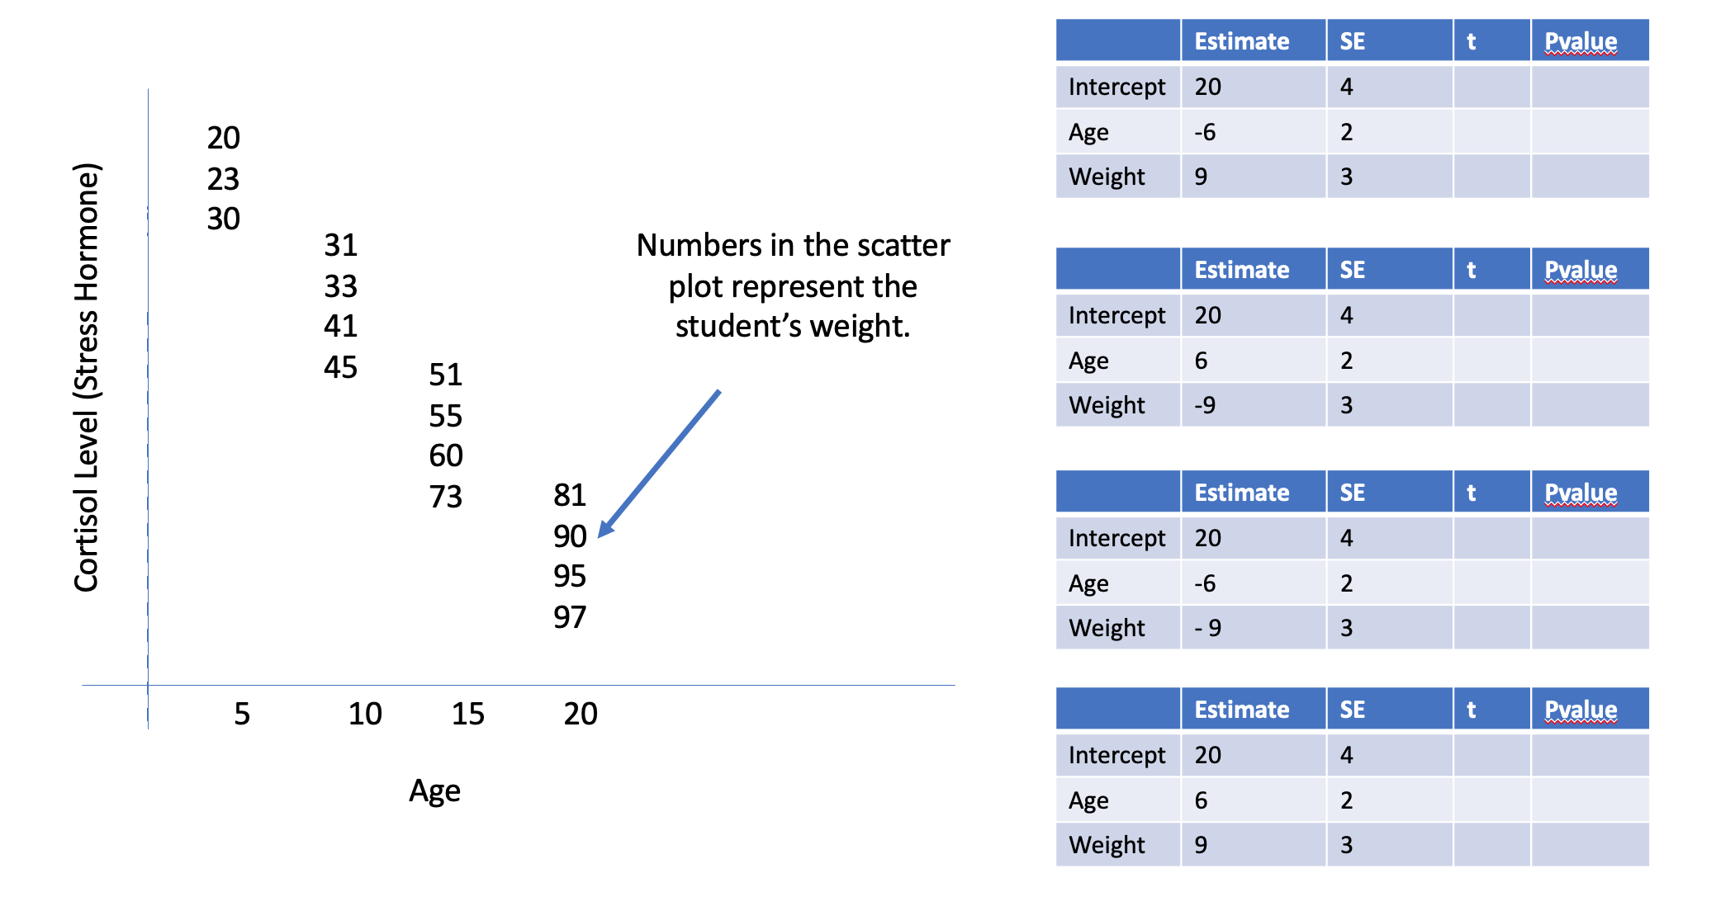

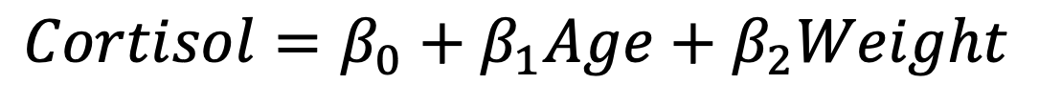
$$Cortisol=β_{0}+β_{1}Age+β_{2}Weight$$

Slide 31
$$Cortisol=β_{0}+β_{1}Age+β_{2}Weight$$

Slide 32
Simply Answer the Question in 13.12 on 2DS!

Slide 33
Break Out

Slide 34
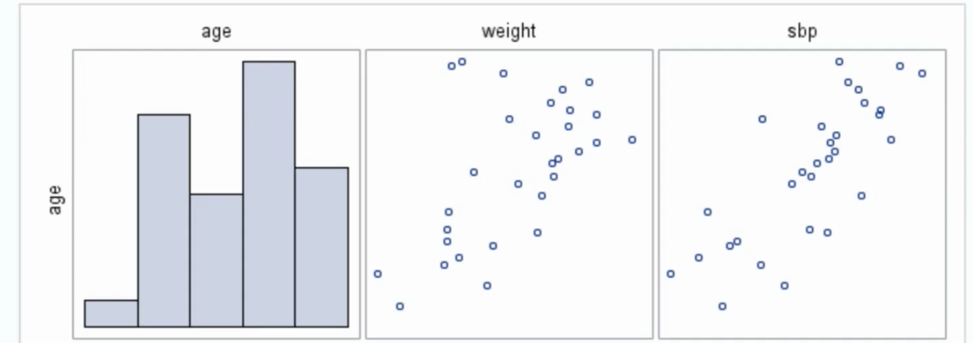
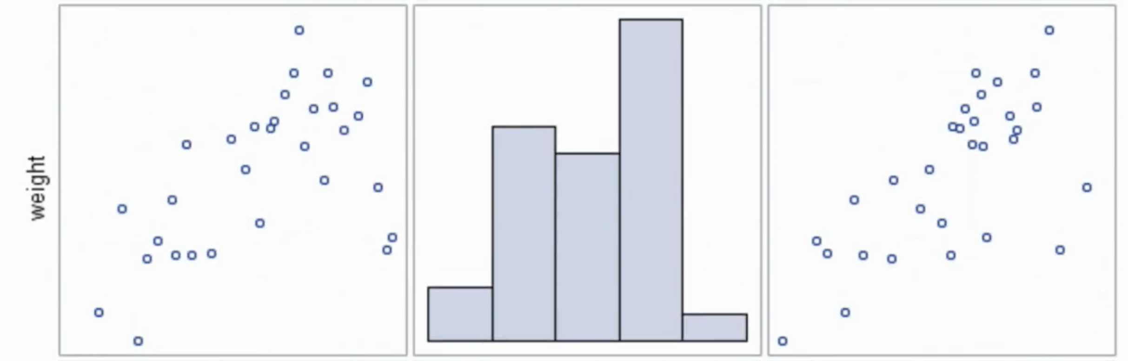
Sub Question 1
What does the scatterplot matrix indicate about the relationship among age, systolic blood pressure, and weight?
There is visual evidence of a relationship between sbp and weight, sbp and age, and also a evidence of linear relationship between weight and age.

Slide 35
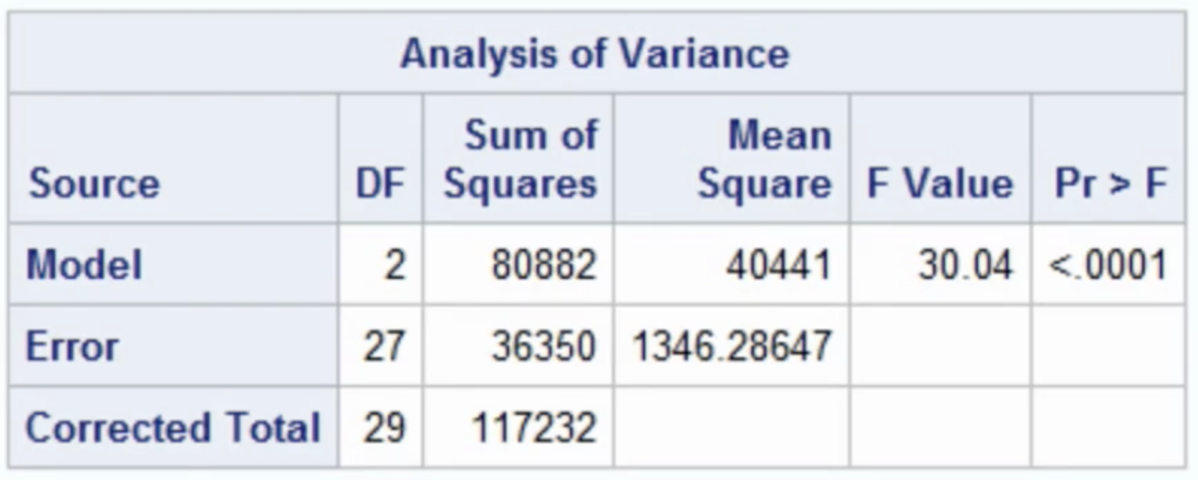
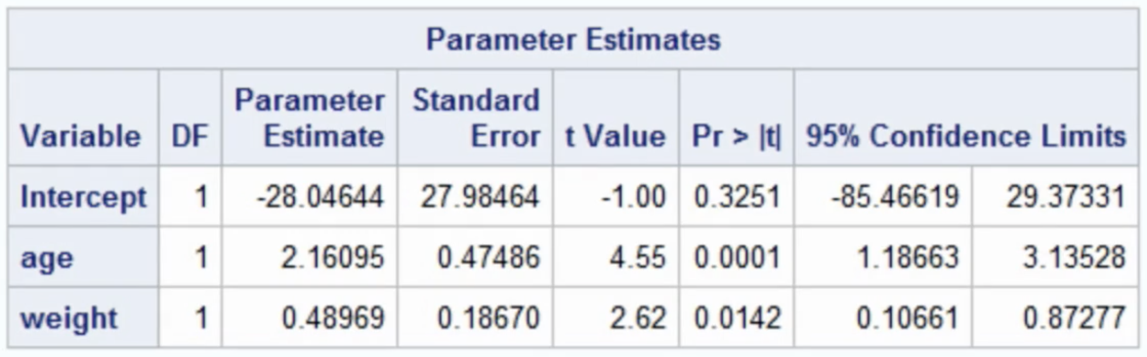
Sub Question 2
Is the combination of age and weight statistically significant for predicting blood pressure? Explain.
Please bring your answer to the live session.
Yes… there is overwhelming evidence to suggest that at least one of the slopes is not equal to zero. Judging from the parameter estimate table, there is overwhelming evidence to suggest that the combination of age and weight are statistically significant in predicting blood pressure.

Slide 36
Sub Question 3
Write down the regression equation, and interpret the value of each slope in the equation.
Regression equation
SBP = -28.04644 + 2.161*age + 0.49*weight
Interpretation:
If age is held constant, we are 95% confident that a 1 lbs increase in weight is associated with an increase in mean blood pressure between .107 and .873 units. Our best estimate is .490 units.
Alternate Interpretation:
For people of the same age, we are 95% confident that a 1 lbs increase in weight is associated with an increase in mean blood pressure between .107 and .873 units. Our best estimate is .490 units.
If weight is held constant, we are 95% confident that a 1 year increase in age is associated with an increase in mean blood pressure between 1.187 an 3.135 units. Our best estimate is 2.161 units.
Alternate Interpretation:
For people of the same weight, we are 95% confident that a 1 year increase in age is associated with an increase in mean blood pressure between 1.187 an 3.135 units. Our best estimate is 2.161 units.

Slide 37
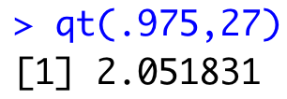
Sub Question 4
Verify the test statistic calculations and the confidence intervals for the variable age, using the parameter estimate table in the output.
Standard error for age: 0.475
t statistic for age: 2.161/0.475 = 4.55
Confidence interval: 2.161 ± t_{.975,27}*0.475
Confidence interval: 2.161 ± 2.052*0.475 = (1.187, 3.135)

Slide 38
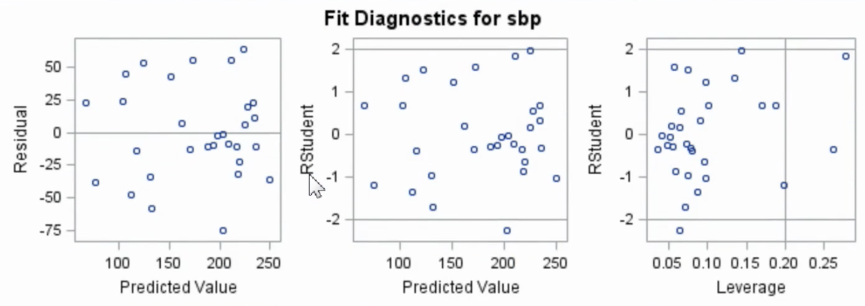
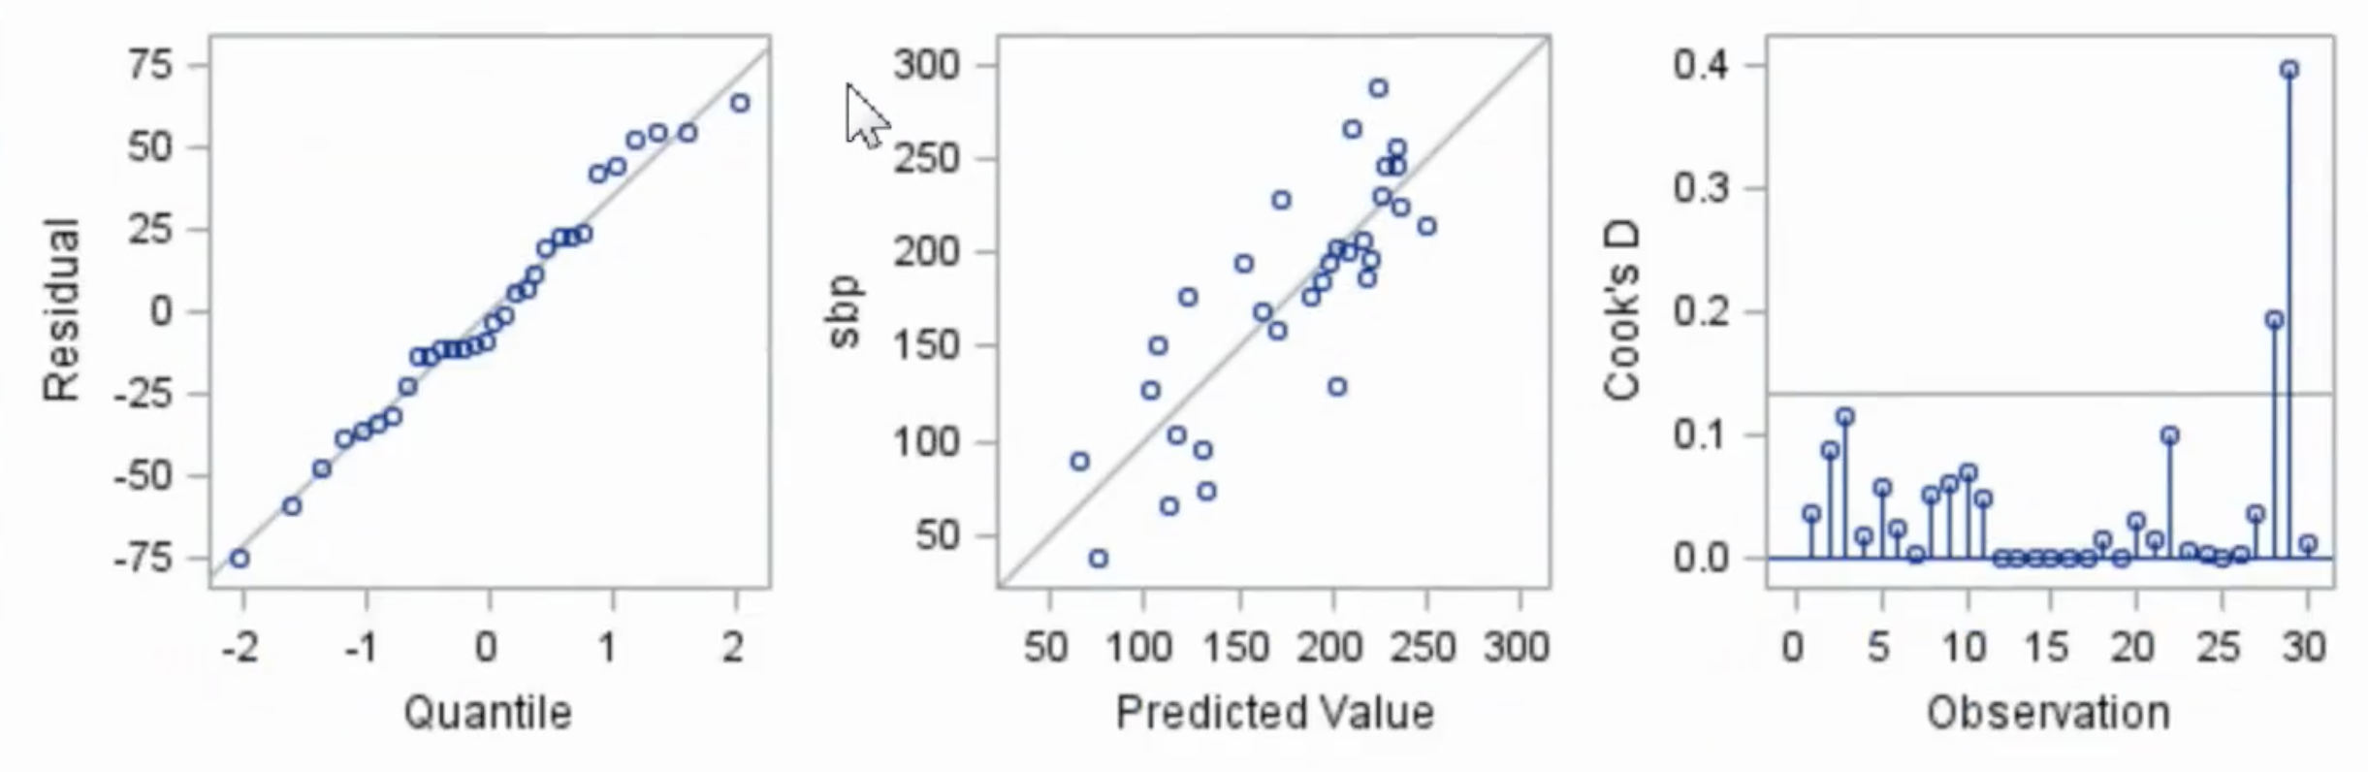
Sub Question 5
Examine the residual plots for age and weight. According to these plots, is a linear model appropriate for these data? Explain.
Yes! The residual scatter plot shows a random cloud around zero, the qq plot is consistent with a normal distribution of residuals and there is only 1 residual with a studentized residual greater than 2 in absolute value (which is what we would expect with 30 observations.)

Slide 39
Review

Slide 40
Echolocation!!!
QOI: Is there a difference in the in-flight energy expenditures among all three animals after body size is accounted for? Explore the possibility of unequal slopes.
In order to answer this question, it will help first to test if all the regression lines are parallel (if the slopes are equal). If they are, then we can check for a difference in energy expenditure across all body sizes simultaneously. See Display 10.5 on page 276.
$$μ\left\{lenergy \right|lmass, TYPE\}= β_{0}{+β}_{1}lmass{+β}_{2}bird{+β}_{3}ebat{+β}_{4}lmass∗bird{+β}_{5} lmass ∗ebat$$
Indicator variables for the variable TYPE.
Which of the three types of animals (bird, ebat, or nebat) is the reference type in this model?
Nebat
It occurs when ebat = 0 and bird = 0.

Slide 41

Echolocation!!!
$$μ\left\{lenergy \right|lmass, TYPE\}= β_{0}{+β}_{1}lmass{+β}_{2}bird{+β}_{3}ebat{+β}_{4}lmass∗bird{+β}_{5} lmass ∗ebat$$
Individual regression equations for each value of TYPE:
Type = ebat occurs when ebat=1 and bird = 0.
0
0
$$μ\left\{lenergy \right|lmass, TYPE=ebat\}= β_{0}{+β}_{1}lmass{+β}_{2}∗0{+β}_{3}∗1{+β}_{4}lmass∗0{+β}_{5} lmass ∗1$$
$$μ\left\{lenergy \right|lmass, TYPE=ebat\}= β_{0}{+β}_{1}lmass{+β}_{3}{+β}_{5} lmass$$
$$μ\left\{lenergy \right|lmass, TYPE=ebat\}= β_{0}{+β}_{3}{+β}_{1}lmass{+β}_{5} lmass$$
$μ\left\{lenergy \right|lmass, TYPE=ebat\}=\left(β_{0}{+β}_{3}\right)+(β_{1}{+β}_{5})lmass$: slope = $β_{1}{+β}_{5}$
Type = bird occurs when ebat=0 and bird = 1.
0
0
$$μ\left\{lenergy \right|lmass, TYPE=bird\}= β_{0}{+β}_{1}lmass{+β}_{2}∗1{+β}_{3}∗0{+β}_{4}lmass∗1{+β}_{5} lmass ∗0$$
$$μ\left\{lenergy \right|lmass, TYPE=bird\}= β_{0}{+β}_{1}lmass{+β}_{2}{+β}_{4} lmass$$
$$μ\left\{lenergy \right|lmass, TYPE=bird\}= β_{0}{+β}_{2}{+β}_{1}lmass{+β}_{4} lmass$$
$μ\left\{lenergy \right|lmass, TYPE=bird\}=\left(β_{0}{+β}_{2}\right)+(β_{1}{+β}_{4})lmass$: slope = $β_{1}{+β}_{4}$
What is the regression equation for nebat (and slope)?
Type = nebat occurs when ebat=0 and bird = 0.
0
0
0
0
$$μ\left\{lenergy \right|lmass, TYPE=nebat\}=β_{0}{+β}_{1}lmass{+β}_{2}∗0{+β}_{3}∗0{+β}_{4}lmass∗0{+β}_{5} lmass ∗0$$
$μ\left\{lenergy \right|lmass, TYPE=nebat\}=β_{0}+β_{1}lmass$: slope = $β_{1}$

Slide 42
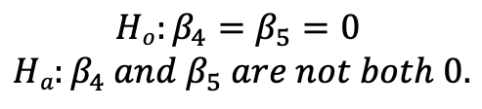
Echolocation!!!
$$μ\left\{lenergy \right|lmass, TYPE\}= β_{0}{+β}_{1}lmass{+β}_{2}bird{+β}_{3}ebat{+β}_{4}lmass∗bird{+β}_{5} lmass ∗ebat$$
Individual regression equations for each value of TYPE:
$μ\left\{lenergy \right|lmass, TYPE=ebat\}=\left(β_{0}{+β}_{3}\right)+(β_{1}{+β}_{5})lmass$: slope = $β_{1}{+β}_{5}$
$μ\left\{lenergy \right|lmass, TYPE=bird\}=\left(β_{0}{+β}_{2}\right)+(β_{1}{+β}_{4})lmass$: slope = $β_{1}{+β}_{4}$
$μ\left\{lenergy \right|lmass, TYPE=nebat\}=β_{0}+β_{1}lmass$: slope = $β_{1}$
All slopes are equal if $β_{1}{+β}_{5}=β_{1}=β_{1}{+β}_{4}, or β_{4}=β_{5}=0$.
$$Ho:β_{4}=β_{5}=0$$
$$Ha:β_{4} and β_{5} are not both 0.$$
We will do this with an Extra Sum of Squares Test
(build your own ANOVA table).

Slide 43
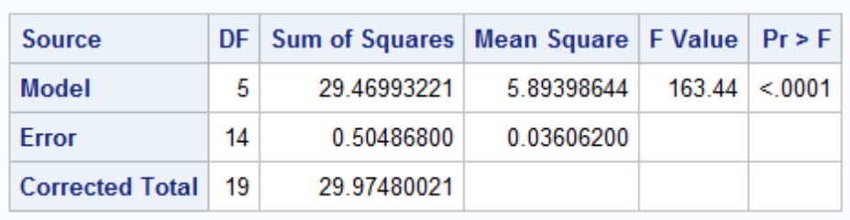
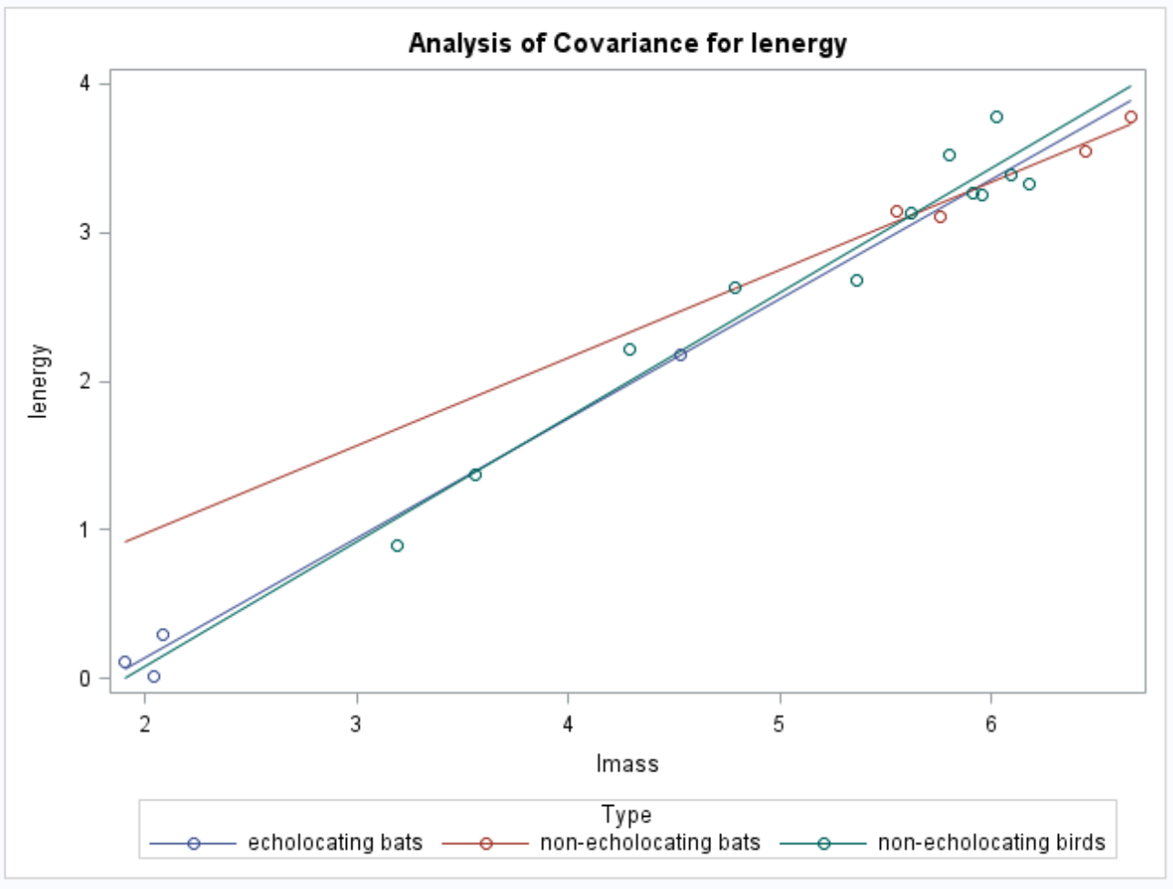
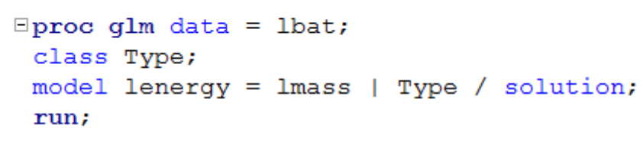
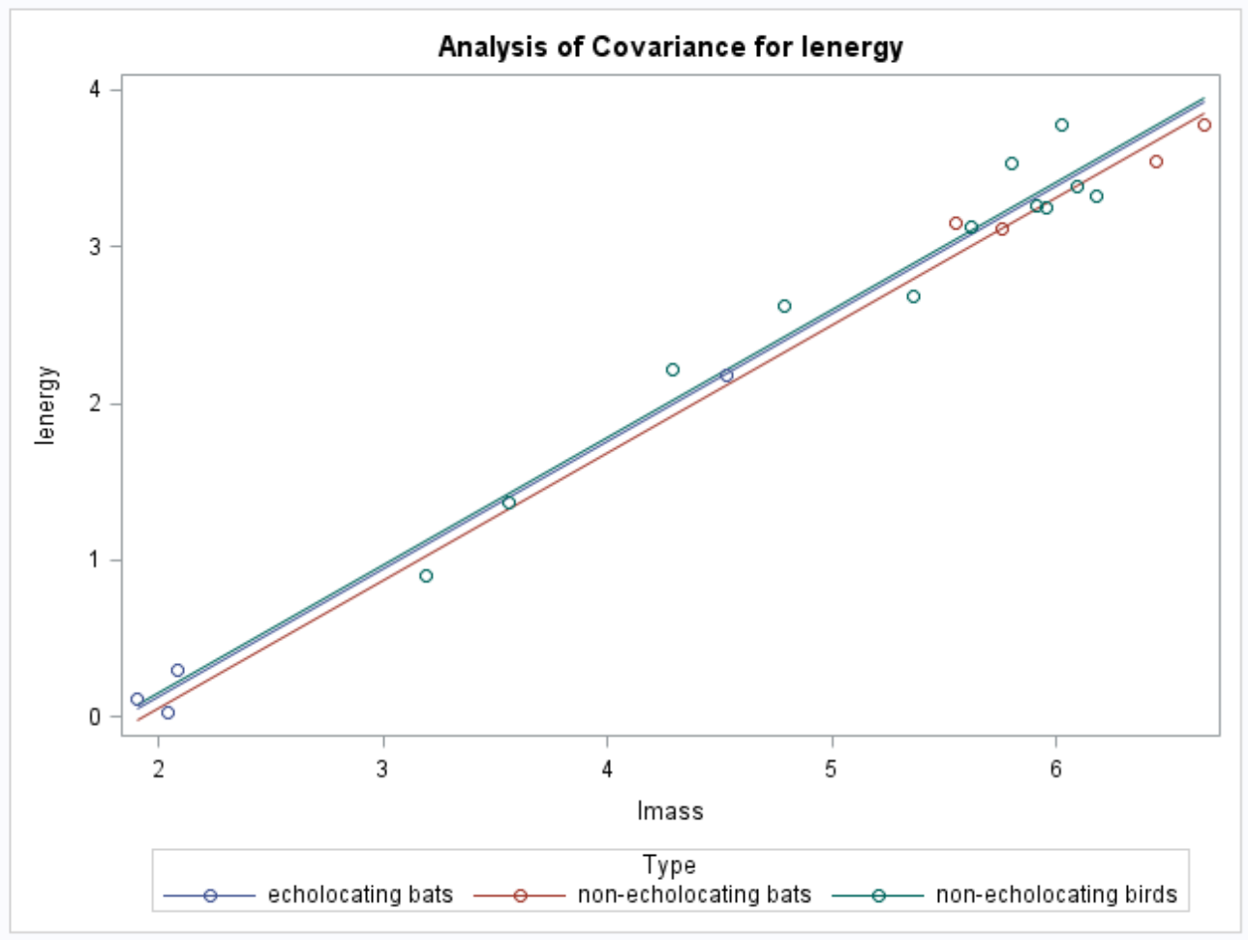
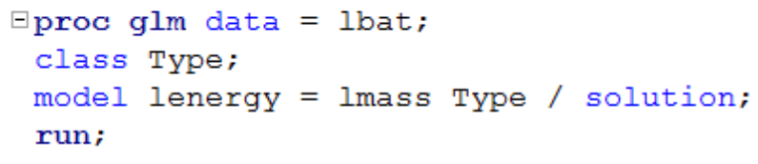
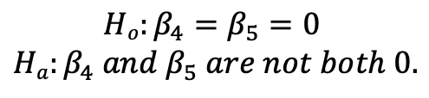
Echolocation!!!
QOI: Is there a difference in the in-flight energy expenditures among animals after body size is accounted for? (Is the model with the interaction between type and body size significantly different from the model without interaction?)
Plan of action: Lack of fit test (also called sum of squares test).
$$Ho:β_{4}=β_{5}=0$$
$$Ha:β_{4} and β_{5} are not both 0.$$
$$μ\left\{lenergy \right|lmass, TYPE\}= β_{0}{+β}_{1}lmass{+β}_{2}bird{+β}_{3}ebat+β_{4} lmass∗bird{+β}_{5} lmass ∗ebat$$
Full Model
$$μ\left\{lenergy \right|lmass, TYPE\}= β_{0}{+β}_{1}lmass{+β}_{2}bird{+β}_{3}ebat$$
Reduced Model

Slide 44
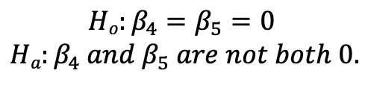
Echolocation!!!
QOI: Is there a difference in the in-flight energy expenditures among animals after body size is accounted for?
$$Ho:β_{4}=β_{5}=0$$
$$Ha:β_{4} and β_{5} are not both 0.$$
$$μ\left\{lenergy \right|lmass, TYPE\}= β_{0}{+β}_{1}lmass{+β}_{2}bird{+β}_{3}ebat+β_{4}lmass∗bird{+β}_{5} lmass ∗ebat$$
Full Model
Reduced Model
Source | Df | SS | MS | F | P-value
Model | 2 | .0485 | .02425 | .67867 | .5232
Error | 14 | .5048 | .0361
Total | 16 | .5533
Source | Df | SS | MS | F | P-value
Model
Error
Total
Full Model
Reduced Model

Slide 45
Echolocation!!!
QOI: Is there a difference in the in-flight energy expenditures among animals after body size is accounted for?
$$Ho:β_{4}=β_{5}=0$$
$$Ha:β_{4} and β_{5} are not both 0.$$
$$μ\left\{lenergy \right|lmass, TYPE\}= β_{0}{+β}_{1}lmass{+β}_{2}bird{+β}_{3}ebat+β_{4}lmass∗bird{+β}_{5} lmass ∗ebat$$
Full Model
Reduced Model
Source | Df | SS | MS | F | P-value
Model | 2 | .0485 | .02425 | .67867 | .5232
Error | 14 | .5048 | .0361
Total | 16 | .5533
Source | Df | SS | MS | F | P-value
Model
Error | 14 | .5048 | .0361
Total | 16 | .5533
Full Model
Reduced Model
Conclusion: There is not sufficient evidence to suggest that the lines are not parallel (p-value = 0.5232 from an Extra Sum of Squares F-test).

Slide 46
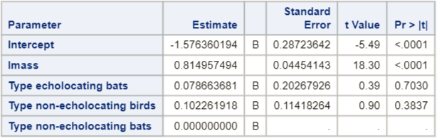
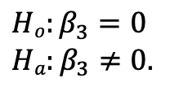
Echolocation!!!
QOI: Is there a difference in the in-flight energy of the TWO BAT types after body size is accounted for?
(Or, are the intercepts for the TWO BAT types different, after knowing that the slopes can be considered equal?)
$$μ\left\{lenergy \right|lmass, TYPE\}= β_{0}{+β}_{1}lmass{+β}_{2}bird{+β}_{3}ebat{+β}_{4}lmass∗bird{+β}_{5} lmass ∗ebat$$
Individual regression equations for each relevant value of TYPE:
$μ\left\{lenergy \right|lmass, TYPE=ebat\}=(β_{0}{+β}_{3})+β_{1}lmass$: intercept = $β_{0}{+β}_{3}$
$μ\left\{lenergy \right|lmass, TYPE=nebat\}= β_{0}+β_{1}lmass$ : intercept = $β_{0}$
Both intercepts are equal if $β_{0}{+β}_{3}=β_{0}, or β_{3}=0$.
$$Ho:β_{3}=0$$
$$Ha:β_{3}≠0.$$
Choosing one of the TYPES of interest to be the reference level makes this easy!
Data are consistent with the hypothesis of equal median in-flight energy expenditures between two bat types after accounting for the mass (size) (p-value = .7030).

Slide 47
Break Out 2

Slide 48
Breakout!: Try it!
Pred $SATScore= β_{0}+β_{1}GPA+ β_{2}Freshman+ β_{3}Sophomore$ $+ β_{4}Junior$
$+ β_{5}Freshman∗GPA$ $+ β_{6}Sophomore∗GPA$ $+ β_{7}Junior∗GPA$
Assume we have randomly sampled 35 students and the sum of squares residual (error) for the fit of the model above was 84.67. We also fit the model without the last three terms:
and found the sum of squares to be 130.7. Find an F-statistic and p-value to test if the slopes are the same for the 4 classifications (senior is the reference level) of high school students. In other words … perform an extra sum of squares test.
Pred $SATScore= β_{0}+β_{1}GPA+ β_{2}Freshman+ β_{3}Sophomore$ $+ β_{4}Junior$
Source | Df | SS | MS | F | P-value
Model
Error
Total
Full Model
Reduced Model

Slide 49
Example Sum of Squares Test
Source | Df | SS | MS | F | P-value
Model
Error |  | 84.67
Total |  | 130.7
Full Model:
Reduced Model:
*Bold entries are from info given directly on prior slide.
Full Model:
Pred $SATScore= β_{0}+β_{1}GPA+ β_{2}Freshman+ β_{3}Sophomore$ $+ β_{4}Junior$
$+ β_{5}Freshman∗GPA$ $+ β_{6}Sophomore∗GPA$ $+ β_{7}Junior∗GPA$
Reduced Model:
Pred $SATScore= β_{0}+β_{1}GPA+ β_{2}Freshman+ β_{3}Sophomore$ $+ β_{4}Junior$

Slide 50
Example Sum of Squares Test
Source | Df | SS | MS | F | P-value
Model
Error | 27 | 84.67
Total | 30 | 130.7
Full Model:
Reduced Model:
Full Model:
Pred $SATScore= β_{0}+β_{1}GPA+ β_{2}Freshman+ β_{3}Sophomore$ $+ β_{4}Junior$
$+ β_{5}Freshman∗GPA$ $+ β_{6}Sophomore∗GPA$ $+ β_{7}Junior∗GPA$
Reduced Model:
Pred $SATScore= β_{0}+β_{1}GPA+ β_{2}Freshman+ β_{3}Sophomore$ $+ β_{4}Junior$

Slide 51
Example Sum of Squares Test
Source | Df | SS | MS | F | P-value
Model | 3 | 46.03
Error | 27 | 84.67
Total | 30 | 130.7
Full Model:
Reduced Model:
Full Model:
Pred $SATScore= β_{0}+β_{1}GPA+ β_{2}Freshman+ β_{3}Sophomore$ $+ β_{4}Junior$
$+ β_{5}Freshman∗GPA$ $+ β_{6}Sophomore∗GPA$ $+ β_{7}Junior∗GPA$
Reduced Model:
Pred $SATScore= β_{0}+β_{1}GPA+ β_{2}Freshman+ β_{3}Sophomore$ $+ β_{4}Junior$

Slide 52
Example Sum of Squares Test
Source | Df | SS | MS | F | P-value
Model | 3 | 46.03 | 15.34
Error | 27 | 84.67 | 3.14
Total | 30 | 130.7
Full Model:
Reduced Model:
Full Model:
Pred $SATScore= β_{0}+β_{1}GPA+ β_{2}Freshman+ β_{3}Sophomore$ $+ β_{4}Junior$
$+ β_{5}Freshman∗GPA$ $+ β_{6}Sophomore∗GPA$ $+ β_{7}Junior∗GPA$
Reduced Model:
Pred $SATScore= β_{0}+β_{1}GPA+ β_{2}Freshman+ β_{3}Sophomore$ $+ β_{4}Junior$

Slide 53
Example Sum of Squares Test
Source | Df | SS | MS | F | P-value
Model | 3 | 46.03 | 15.34 | 4.89
Error | 27 | 84.67 | 3.14
Total | 30 | 130.7
Full Model:
Reduced Model:
Full Model:
Pred $SATScore= β_{0}+β_{1}GPA+ β_{2}Freshman+ β_{3}Sophomore$ $+ β_{4}Junior$
$+ β_{5}Freshman∗GPA$ $+ β_{6}Sophomore∗GPA$ $+ β_{7}Junior∗GPA$
Reduced Model:
Pred $SATScore= β_{0}+β_{1}GPA+ β_{2}Freshman+ β_{3}Sophomore$ $+ β_{4}Junior$

Slide 54
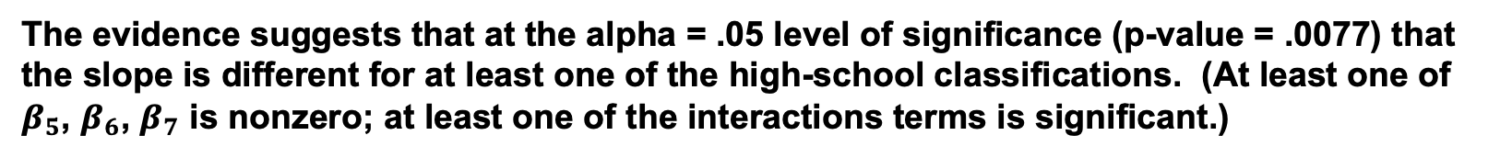
Example Sum of Squares Test
Source | Df | SS | MS | F | P-value
Model | 3 | 46.03 | 15.34 | 4.89 | .0077
Error | 27 | 84.67 | 3.14
Total | 30 | 130.7
Full Model:
Reduced Model:
The evidence suggests that at the alpha = .05 level of significance (p-value = .0077) that the slope is different for at least one of the high-school classifications. (At least one of $β_{5}$, $β_{6}$, $β_{7}$ is nonzero; at least one of the interactions terms is significant.)
Full Model:
Pred $SATScore= β_{0}+β_{1}GPA+ β_{2}Freshman+ β_{3}Sophomore$ $+ β_{4}Junior$
$+ β_{5}Freshman∗GPA$ $+ β_{6}Sophomore∗GPA$ $+ β_{7}Junior∗GPA$
Reduced Model:
Pred $SATScore= β_{0}+β_{1}GPA+ β_{2}Freshman+ β_{3}Sophomore$ $+ β_{4}Junior$

Slide 55
Confidence Intervals for Linear Combinations of Coefficients

Slide 56
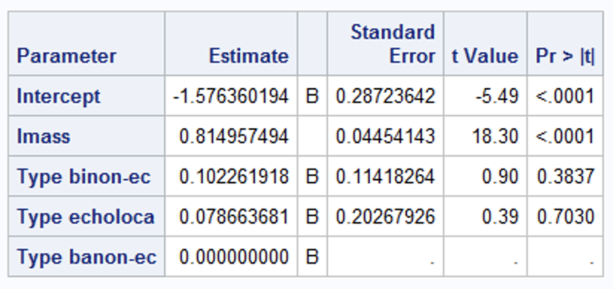
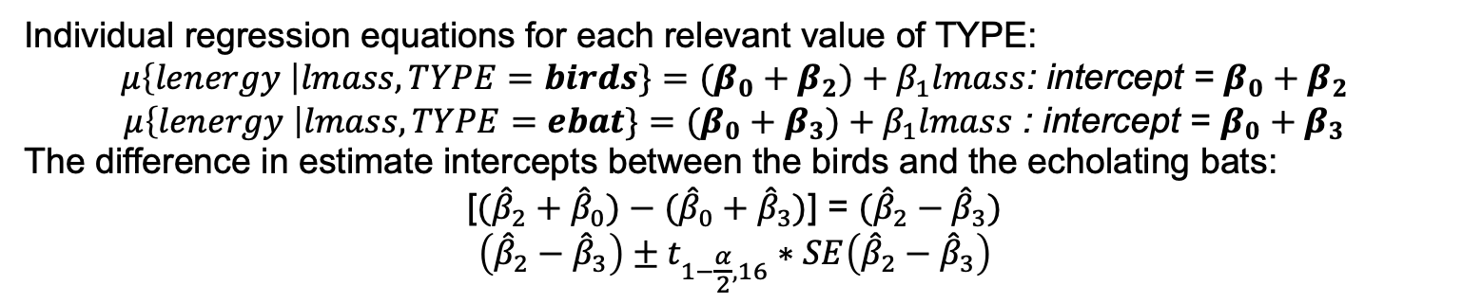
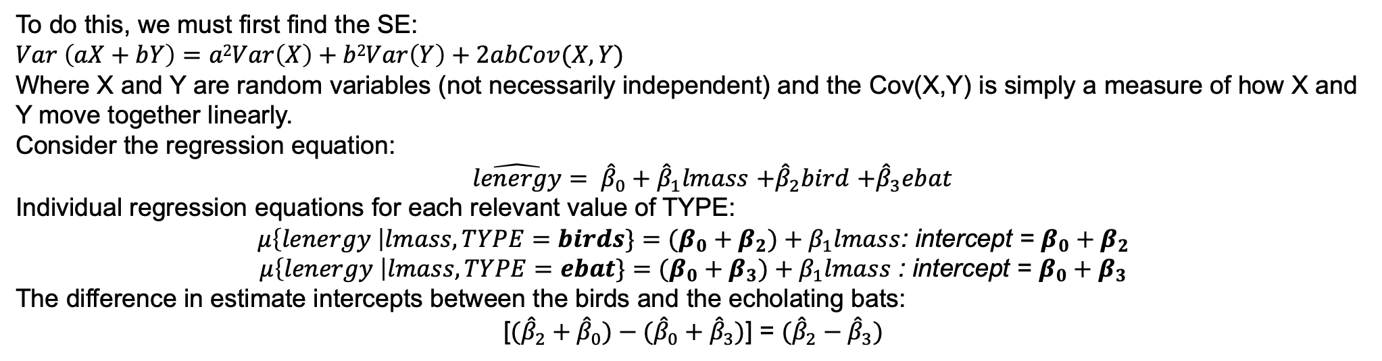
Confidence Interval for a Difference in Parameters
Find a 95% confidence interval for the difference in the intercept between non-echolocating birds and echolocating bats.
$\hat{lenergy}= {\hat{β}}_{0}+{\hat{β}}_{1}lmass$ $+{\hat{β}}_{2}bird$ $+{\hat{β}}_{3}ebat$
Individual regression equations for each relevant value of TYPE:
$μ\left\{lenergy \right|lmass, TYPE=birds\}=(β_{0}+β_{2})+β_{1}lmass$: intercept = $β_{0}+β_{2}$
$μ\left\{lenergy \right|lmass, TYPE=ebat\}=(β_{0}+β_{3})+β_{1}lmass$ : intercept = $β_{0}+β_{3}$
The difference in estimate intercepts between the birds and the echolating bats:
[$({\hat{β}}_{2}+{\hat{β}}_{0})−({\hat{β}}_{0}+{\hat{β}}_{3})$] = $({\hat{β}}_{2}−{\hat{β}}_{3})$
$$\left({\hat{β}}_{2}−{\hat{β}}_{3}\right)±t_{1−\frac{α}{2},16}∗SE\left({\hat{β}}_{2}−{\hat{β}}_{3}\right)$$
proc glm data = echolocation;
class type (ref = "banon-ec");
model lenergy = lmass | type /solution;
run;
?
To do this, we must first find the SE:
$$Var \left(aX+bY\right)=a2Var\left(X\right)+b2Var\left(Y\right)+2abCov(X,Y)$$
Where X and Y are random variables (not necessarily independent) and the Cov(X,Y) is simply a measure of how X and Y move together linearly.
Consider the regression equation:
$\hat{lenergy}= {\hat{β}}_{0}+{\hat{β}}_{1}lmass$ $+{\hat{β}}_{2}bird$ $+{\hat{β}}_{3}ebat$
Individual regression equations for each relevant value of TYPE:
$μ\left\{lenergy \right|lmass, TYPE=birds\}=(β_{0}+β_{2})+β_{1}lmass$: intercept = $β_{0}+β_{2}$
$μ\left\{lenergy \right|lmass, TYPE=ebat\}=(β_{0}+β_{3})+β_{1}lmass$ : intercept = $β_{0}+β_{3}$
The difference in estimate intercepts between the birds and the echolating bats:
[$({\hat{β}}_{2}+{\hat{β}}_{0})−({\hat{β}}_{0}+{\hat{β}}_{3})$] = $({\hat{β}}_{2}−{\hat{β}}_{3})$

Slide 57
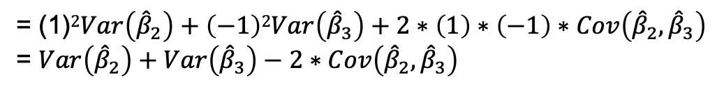

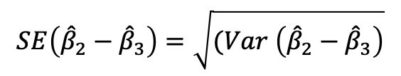
Confidence Interval for a Difference in Parameters
Find a 95% confidence interval for the difference in the intercept between non-echolocating birds and echolocating bats.
$\hat{lenergy}= {\hat{β}}_{0}+{\hat{β}}_{1}lmass$ $+{\hat{β}}_{2}bird$ $+{\hat{β}}_{3}ebat$
$$\left({\hat{β}}_{2}−{\hat{β}}_{3}\right)±t_{1−\frac{α}{2},16}∗SE\left({\hat{β}}_{2}−{\hat{β}}_{3}\right)$$
To do this, we must first find the SE:
$$Var \left(aX+bY\right)=a2Var\left(X\right)+b2Var\left(Y\right)+2abCov(X,Y)$$
Where X and Y are random variables (not necessarily independent) and the Cov(X,Y) is simply a measure of how X and Y move together linearly.
In a regression equation, the $\hat{β}s$ are the random variables and the “explanatory variables” are actually constant. This is because we know the values of the EVs and have to estimate the values of the $βs.$
To find the variance of the difference in estimated intercepts between the birds and the echolating bats:
$$Var \left({\hat{β}}_{2}−{\hat{β}}_{3}\right)$$
= (1)$2Var\left({\hat{β}}_{2}\right)+\left(−1\right)2Var\left({\hat{β}}_{3}\right)+2∗\left(1\right)∗\left(−1\right)∗Cov\left({\hat{β}}_{2},{\hat{β}}_{3}\right)$
= $Var\left({\hat{β}}_{2}\right)+Var\left({\hat{β}}_{3}\right)−2∗Cov\left({\hat{β}}_{2},{\hat{β}}_{3}\right)$
$$SE\left({\hat{β}}_{2}−{\hat{β}}_{3}\right)=\sqrt{(Var \left({\hat{β}}_{2}−{\hat{β}}_{3}\right)}$$

Slide 58
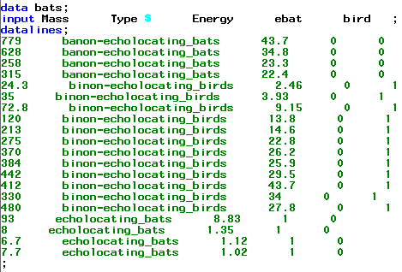



How to Find the Var/Cov Matrix in SAS?
1. Download the bat data.
2. Manipulate the data in Excel (create and code indicator variables).
(You can do this in SAS as well … instead of Excel.)
3. Make a data statement for the manipulated data in SAS.
4. Make the proc reg statement.
$\hat{lenergy}= {\hat{β}}_{0}+{\hat{β}}_{1}lmass$ $+{\hat{β}}_{2}bird$ $+{\hat{β}}_{3}ebat$
$$Var \left({\hat{β}}_{2}−{\hat{β}}_{3}\right)=Var\left({\hat{β}}_{2}\right)+Var\left({\hat{β}}_{3}\right)−2∗Cov\left({\hat{β}}_{2},{\hat{β}}_{3}\right)$$
df = 16 (n = 20)
MOE = t_{16,.975} * SE
MOE = 2.12 * .1576
MOE = .3341
95% CI: (.0236 ± .3341)
95% CI: (−.3105, .3577)
$$Var \left({\hat{β}}_{2}−{\hat{β}}_{3}\right)=0.0130377+0.0410789−2∗0.01463932$$
Note:
Cov(X,X) = Var(X)
$$Var \left({\hat{β}}_{2}−{\hat{β}}_{3}\right)=0.024838$$
$$St Error \left({\hat{β}}_{2}−{\hat{β}}_{3}\right)=\sqrt{0.024838}=0.1576$$

Slide 59




Energy Cost of Echolocation
Find a 95% confidence interval for the difference in the intercepts between non-echolocating birds and echolocating bats.
$$μ\left\{lenergy \right|lmass, TYPE\}= β_{0}{+β}_{1}lmass{+β}_{2}nebat{+β}_{3}bird$$
Individual regression equations for each relevant value of TYPE:
$μ\left\{lenergy \right|lmass, TYPE=birds\}=(β_{0}+β_{3})+β_{1}lmass$: intercept =$β_{0}+β_{3}$
$μ\left\{lenergy \right|lmass, TYPE=ebat\}=β_{0}+β_{1}lmass$ : intercept = $β_{0}$
The difference in intercepts is $\left(β_{0}{+β}_{3}\right)−β_{0}=β_{3}$.
Ref = echolocating bat
To find a confidence interval for the difference in intercepts for these two categories, we just need a confidence interval for $β_{3}$.
df = 16 (n = 20)
MOE = t_{16,.975} * SE
MOE = 2.12 * .1576
MOE = .3341
95% CI: (.0236 ± .3341)
95% CI: (−.3105, .3577)

Slide 60








Interpretation
Find a 95% confidence interval for the difference in the intercepts between non-echolocating birds and echolocating bats.
$$μ\left\{lenergy \right|lmass, TYPE\}= β_{0}{+β}_{1}lmass{+β}_{2}nebat{+β}_{3}bird$$
Ref = echolocating bat
Since we are assuming the lines are parallel, we are 95% confident that the true difference in mean log energy expenditure is contained in the interval (−.3105, .3577). Since zero is in the interval, it is plausible given the data that there is not a difference in the means (and thus there is not a Significant difference in the median energy expenditure between the non-echolocating birds and echolocating bats.

Slide 61



Find a 95% confidence interval for the difference in the intercepts between non-echolocating birds and echolocating bats.
Two ways:
A. Using the Variance/Covariance Method in proc reg. (Hint: You will have had to adjust the data … use the following output below to think about how you would construct this interval.)
B. Using the Reference Method in proc glm.
Make one of the types of interest a reference level.

Slide 62
Breakout 3

Slide 63




A. Using the Reference method in proc glm. Just think about what you would do. B. Using the Variance / Covariance Method in proc reg. (Hint: You will have had to adjust the data … use the following output below to think about how you would construct this interval.)
Find a 95% confidence interval for the difference in the intercepts between non-echolocating birds and NON-echolocating bats. (Categories of interest have changed!)
Two ways:
Make one of the types of interest a reference level.
Note: The animals have been recoded. The reference has changed.

Slide 64


A. Using the Reference method in proc glm. Find a 95% confidence interval for the difference between the intercepts for the non-echolocating bats and birds. ($β_{2}$)
$$μ\left\{lenergy\right\}= β_{0}+β_{1}lmass+β_{2}bird+β_{3}ebat$$
Ref = non-echolocating bat
df = 16 (n=20)
MOE = t_{16,.975}*SE
MOE = 2.12 * .1142
MOE = .2421
95% CI: (.10226 ± .2421)
95% CI: (-.13944, .34436)

Slide 65



B. Using the Variance / Covariance Method in proc reg. (Hint: You will have to adjust the data!)
$$μ\left\{lenergy\right\}= β_{0}+β_{1}lmass+β_{2}bird+β_{3}nebat$$
Ref = echolocating bat
Find a 95% confidence interval for the difference between the intercepts for the non-echolocating bats and birds.
$$Var \left({\hat{β}}_{2}−{\hat{β}}_{3}\right)=Var\left({\hat{β}}_{2}\right)+Var\left({\hat{β}}_{3}\right)−2Cov({\hat{β}}_{2},{\hat{β}}_{3})$$
$$Var \left({\hat{β}}_{2}−{\hat{β}}_{3}\right)=.02484+.04108−2(.02644)$$
$$Var \left({\hat{β}}_{2}−{\hat{β}}_{3}\right)= .01304$$
${\hat{β}}_{2}−$ ${\hat{β}}_{3}= .02360 − \left(−.07866\right)= .10266$
SE$\left({\hat{β}}_{2}−{\hat{β}}_{3}\right)= \sqrt{.01304}=.1142$
df = 16 (n=20)
MOE = t_{16,.975}*SE
MOE=2.12* .1142
MOE = .2421
95% CI: (.10226 ± .2421)
95% CI: (-.13944, .34436)
Same as before!

Slide 66

Variance Covariance Matrix in R

Slide 67




Another Example: Metabolism Study Variance / Covariance Method
Find a 95% confidence interval for the expected log lifespan of the Echidna given its log metabolism and its log mass.
$$μ\left\{\log\left(life\right)\right\}=β_{0}+β_{1}log⁡(metab)+β_{2}log⁡(mass)$$
$$μ\left\{\log\left(life\right)\right\}=3.7193−0.3161\log\left(metab\right)+0.5346 log⁡(mass)$$
$$μ\left\{\log\left(life\right)|logmass=.91629, logmetab=5.7104\right\}$$
$$=3.7193−0.3161∗5.7104+0.5346∗0.91629$$
$μ\left\{\log\left(life\right)|logmass=.91629, logmetab=5.7104\right\}$=2.404
Point estimate (center) for confidence interval
$$Var(\text{μ}\text{\{}\text{log}\text{(}\text{life}\text{) |}\text{logmass}\text{=}\text{.91629}\text{, }\text{logmetab}\text{=}\text{5.7104}\text{\}})$$
$$=Var({\hat{β}}_{0}+5.7104{\hat{β}}_{1}+.91629{\hat{β}}_{2})$$

Slide 68
Another Example!

Slide 69




Find a 95% confidence interval for the expected log lifespan of the Echidna given its log metabolism and its log mass.
$$μ\left\{\log\left(life\right)\right\}=β_{0}+β_{1}log⁡(metab)+β_{2}log⁡(mass)$$
$$Var(\text{μ}\text{\{}\text{log}\text{(}\text{life}\text{) |}\text{logmass}\text{=}\text{.91629}\text{, }\text{logmetab}\text{=}\text{5.7104}\text{\})}$$
$$=Var({\hat{β}}_{0}+5.7104{\hat{β}}_{1}+.91629{\hat{β}}_{2})$$
$$Var\left(β_{0}+{aβ}_{1}+{bβ}_{2}\right)=$$
$$Var\left({\hat{β}}_{0}\right)+a^{2}Var\left({\hat{β}}_{1}\right)+b^{2}Var\left({\hat{β}}_{2}\right)+ 2aCov\left({\hat{β}}_{0},{\hat{β}}_{1}\right)+2bCov\left({\hat{β}}_{0},{\hat{β}}_{2}\right)+2abCov\left({\hat{β}}_{1},{\hat{β}}_{2}\right)$$
$$Var(\text{μ}\text{\{}\text{log}\text{(}\text{life}\text{) |}\text{logmass}\text{=}\text{.91629}\text{, }\text{logmetab}\text{=}\text{5.7104}\text{\})}={.2343+\left(5.7104\right)}^{2}(.0073){+ \left(.91629\right)}^{2}\left(.0041\right)$$
$$+2\left(5.7104\right)\left(−.04129\right)+2\left(.91629\right)\left(.03046\right)+2\left(5.7104\right)(.91629)(−.00541)$$
$$Var\left(\text{μ}\text{\{}\text{log}\text{(}\text{life}\text{) |}\text{logmass}\text{=}\text{.91629}\text{, }\text{logmetab}\text{=}\text{5.7104}\text{\}}\right)=.004236$$
$$→SE\left(\text{μ}\text{\{}\text{log}\text{(}\text{life}\text{) |}\text{logmass}\text{=}\text{.91629}\text{, }\text{logmetab}\text{=}\text{5.7104}\text{\}}\right)= \sqrt{.0042}=.06509$$
Remember this!
df = 92 (n=95)
MOE = t_{92,.975} * $SE$
MOE = 1.986 * .06509
MOE = 0.129
95% CI: (2.404 ± 0.129)
95% CI: (2.275, 2.533)
Remember this!

Slide 70


Find a 95% confidence interval for the expected log lifespan of the Echidna given its log metabolism and its log mass.
Example: Metabolism Study Re-centering method
Want a 95% CI for$\text{μ}\text{\{}\text{log}\text{(}\text{life}\text{) |}\text{logmass}\text{=}\text{.91629}\text{, }\text{logmetab}\text{=}\text{5.7104}\text{\}}$.
Create new variables so that the values of independent variables of interest will equal 0.
When logmass = .91629, nlogmass = logmass - .91629=.91629-.91629=0
When logmetab = 5.7104, nlogmetab = logmetab – 5.7104=5.7104-5.7104=0
So, $\text{μ}\text{\{}\text{log}\text{(}\text{life}\text{) |}\text{logmass}\text{=}\text{.91629}\text{, }\text{logmetab}\text{=}\text{5.7104}\text{\}=}\text{μ}\text{\{}\text{log}\text{(}\text{life}\text{) |}\text{n}\text{logmass}\text{=0, }\text{n}\text{logmetab}\text{=0\}}$
$$\text{μ}\text{\{}\text{log}\text{(}\text{life}\text{) |}\text{n}\text{logmass}\text{, }\text{n}\text{logmetab}\text{\}}={β′}_{0}+{β′}_{1}nlogmetab+{β′}_{2}nlogmass$$
$$\text{μ}\text{\{}\text{log}\text{(}\text{life}\text{) |}\text{n}\text{logmass}\text{=0, }\text{n}\text{logmetab}\text{=0\}}={β′}_{0}+{β′}_{1}∗0+{β^{′}}_{2}∗0={β′}_{0}$$
A 95% CI for$\text{μ}\text{\{}\text{log}\text{(}\text{life}\text{) |}\text{n}\text{logmass}\text{=0, }\text{n}\text{logmetab}\text{=0\}}$= a 95% CI for ${β′}_{0}$.
df = 92 (n=95)
MOE = t_{92,.975} * SE
MOE = 1.986 * .06509
MOE = 0.129
95% CI: (2.404 ± 0.129)
95% CI: (2.275, 2.533)

Slide 71
Example: Metabolism Study: Re-centering method
$$\text{μ}\text{\{}\text{log}\text{(}\text{life}\text{)\}}=β_{0}+β_{1}log⁡(metab)+β_{2}log⁡(mass)$$
n = 95
When logmass = .91629 and logmetab = 5.7104, the expected mean log(life) is 2.404 and a 95% CI is (2.275, 2.533). On the original scale, for a mammal with a mass of 2.5 kg and a metabolism of 302 units, the expected median lifespan is e^{2.404} =11.07 years. A 95% CI for the median lifespan for a mammal with these attributes is (e^{2.275},e^{2.533}) = (9.73, 12.59) years.

Slide 72
Question 2: Takeaways!
Please provide at least 4 takeaways from this section and any questions that you may have. These questions will help design the live session for this unit.
This question will be the last question of every For Live Session Assignment. The idea is that this deck will serve as a document that you can reference in the future to remember what was covered in this section. For instance, this may come in handy for the Capstone and will hopefully become useful in your career. Most immediately, it may become handy as a quick reference for your Midterm and Final! Some students find it very useful and spend a few slides summarizing the asynch material while others learn different ways and only had the minimum 4 takeaways. Either is fine and will earn you full credit for this question.

Slide 73
Question 3: Questions!
Please provide any question or topics of discussion that came up in this Unit! These will help help us optimize our live session for maximum learning and takeaways!
This question will be the last question of every For Live Session Assignment. The idea is that this deck will serve as a document that you can reference in the future to remember what was covered in this section. For instance, this may come in handy for the Capstone and will hopefully become useful in your career. Most immediately, it may become handy as a quick reference for your Midterm and Final! Some students find it very useful and spend a few slides summarizing the asynch material while others learn different ways and only had the minimum 4 takeaways. Either is fine and will earn you full credit for this question.

Slide 74
End For Live Session Assignment Unit 12!

